Slide 1
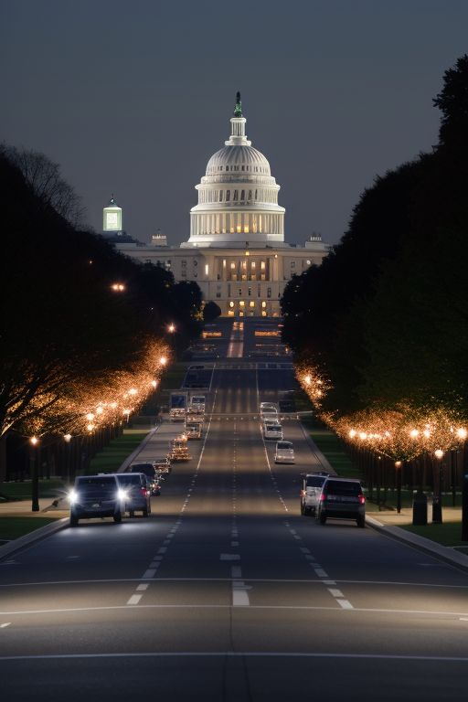
Washington DC Street Light Visualisation and Analysis
Data Visualisation Track
Group 2
Fabiano Santos
Madeleine Chapman
Oliver Uy
Laura Rui Liu
Lewis Trenerry

Slide 2

Data
Washington DC Street Light data
CSV file consisting of 72k rows
Cleaned and stored in pandas dataframe
Astronomical daylight /darkness data for Washington DC
Web page scraped for 2023 data
Data cleaned and summarised in data frame by month and total time of darkness
Combining data sources
Created PostgreSQL databse
Integrate data and merge tables

Slide 3








Pathway to Success
Brainstorming
Extract
Export
Data Manipulation
Track
Transform
Import
Visualisations
Discussed options
Identified sources
Split work
Web Scraping
Download files
Cleansing
Structuring
CSV files ready
Created DB
Read from DB
Charts
Maps

Slide 4
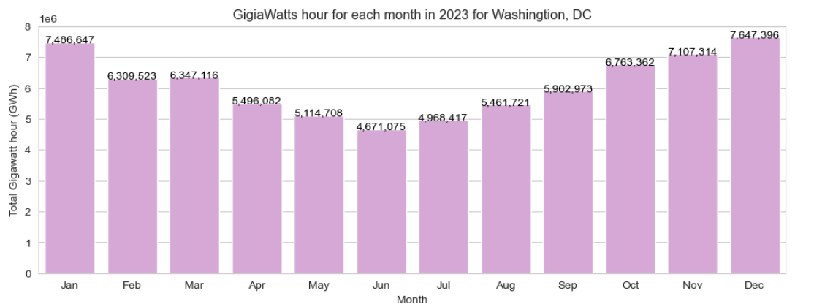
Bar Chart
Libraries used:
seaborn
Matplotlib.pyplot
Insights:
Provides monthly gigawatt hour usage insight
Would be useful in comparison to previous years data
Gives total street light grid demand view which may assist with macro level analysis

Slide 5
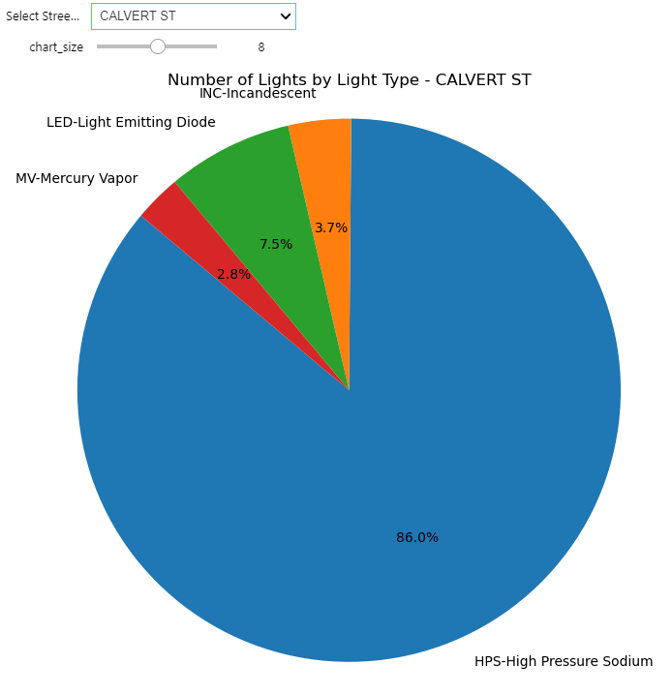
Pie Chart
Libraries used:
Matplotlib.pyplot
Ipywidgets to enable interactive dropdown box
Insights:
Enables detailed street insights on light types and proportions
Light types often have different energy efficiencies, this tool would allow for targeted roll out of new technologies
Works in conjunction with the Map visualization tool

Slide 6
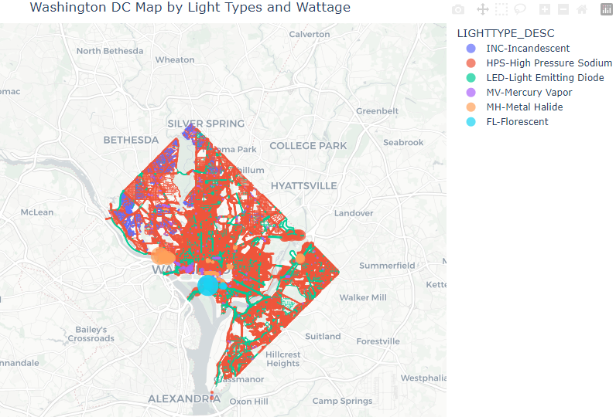
Map
Libraries used:
geopandas
shapely.geometry
plotly.express
Insights:
Facilitates seamless navigation of Washington DC’s network.
Enables rapid understanding of the types of lights and their wattage across locations.
Provides users information to make swift comparison of light patterns and clusters across streets and neighborhoods.

Slide 7
References
OpenAI. (2024). ChatGPT. Retrieved April 11, 2024 from https://openai.com/chatgpt
OpenData DC. (2024). Streetlight Locations. Retrieved April 4, 2024, from https://opendata.dc.gov/datasets/6cb6520725b0489d9a209a337818fad1_90/explore?location=38.894874%2C-77.022089%2C15.00
Perchance. (2024). AI Text-to-Image Generator. Retrieved April 13, 2024, from https://perchance.org/ai-text-to-image-generator
Plotly. (2024). Mapbox Density Heatmaps. Retrieved April 9, 2024, from https://plotly.com/python/mapbox-density-heatmaps/
U.S. Naval Observatory. (2023). Daylight Duration for Washington, DC. Retrieved April 4, 2024 from https://aa.usno.navy.mil/calculated/durdaydark?year=2023&task=1&lat=38.89&lon=-77.03&label=Washington%2C+DC&tz=5&tz_sign=-1&submit=Get+Data

